Slide 1
Distributed AlphaZero: Data Generation and Model Training using Distributed Reinforcement Learning
Capt Drew Gibson

Slide 2
Overview
AlphaZero Background
AlphaZero Architecture
Monte Carlo Tree Search (MCTS)
AlphaZero’s Limitations
Procedure Overview
Network Setup
Challenges with Distribution
Results

Slide 3
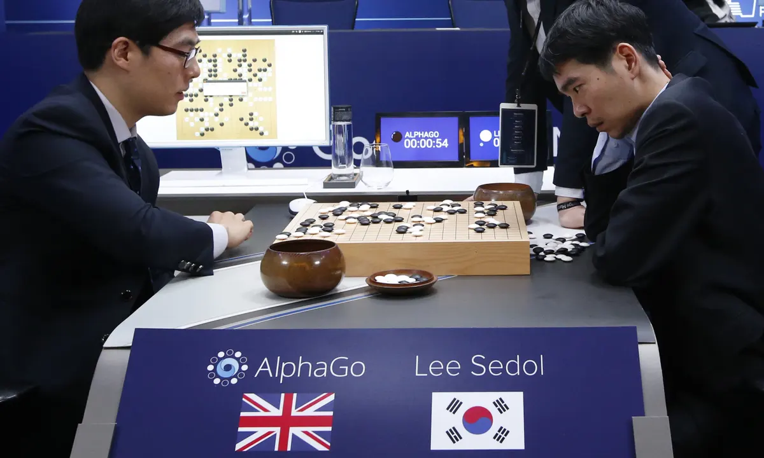
AlphaZero Background
January 2016 – Google’s Deepmind publishes Mastering the game of Go with deep neural networks and tree search (Silver et al.) after AlphaGo beats the European Go Champion
March 2016 – AlphaGo beats World Champion Lee Sedol

Slide 4
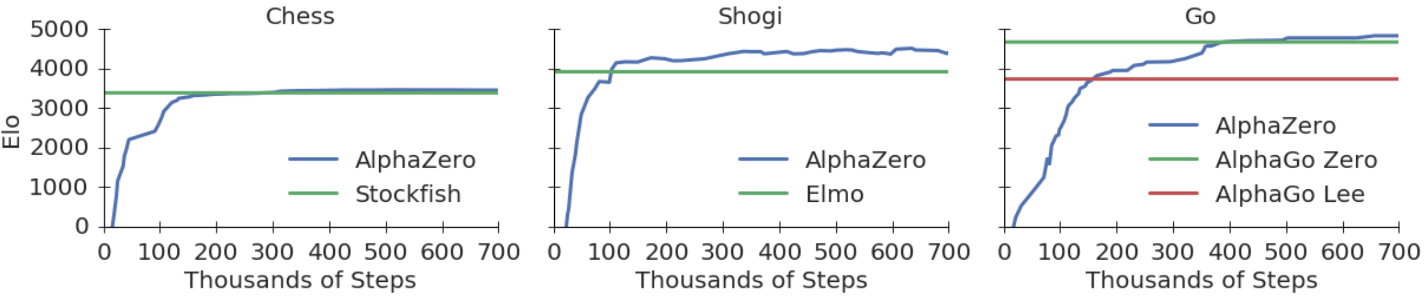
AlphaZero Background (contd.)
December 2017 – DeepMind publishes Mastering Chess and Shogi by Self-Play with a General Reinforcement Learning Algorithm (Silver et al.) and achieved superhuman play in Chess, Shogi, and Go with a single algorithm, AlphaZero.

Slide 5
AlphaZero Architecture
AlphaZero has two components:
Deep Residual Neural Network
Monte Carlo Tree Search (MCTS)
The MCTS is guided and optimized using the Neural Network, which is trained on the MCTS’ output in a self-reinforcing feedback loop.

Slide 6
Monte Carlo Tree Search (MCTS)
MCTS is a “dumb” tree search method – requiring no specialized knowledge of the game at hand.
In a particular position, find the possible moves. Evaluate each move by randomly playing out a game and recording the result, and iteratively deepen the search on promising moves.

Slide 7
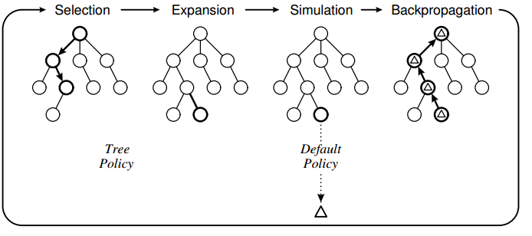
Monte Carlo Tree Search (contd.)
Selection is based on a balance of value and exploration.
In pure MCTS, the Default Policy is random.
In AlphaZero, Default Policy is a deep learning evaluation.

Slide 8
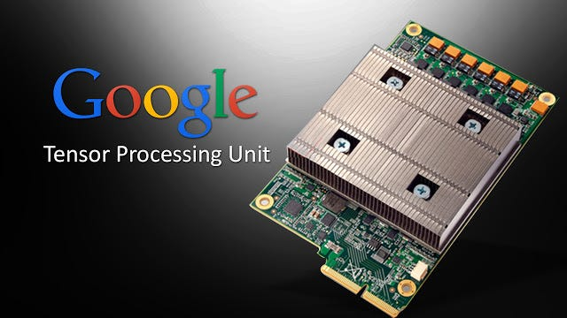
AlphaZero’s Limitations
The neural network has no initial understanding, and can only learn on the basis of many, deep MCTS searches, making AlphaZero computationally expensive.
AlphaGo was trained on 50 GPUs for one week, AlphaZero on 5064 TPUs for 34 hours.

Slide 9
Procedure Overview
Using pure MCTS, generate initial training examples and perform model selection and distributed hyperparameter tuning using Ray Tune.
Using AlphaZero MCTS, perform the iterative learning process, monitoring performance relative to historical versions to determine when to end training.

Slide 10
Network Setup
Desktop with GPU, 2 Laptops with GPUs, 2 Raspberry Pis (3 Model B and 4 Model B)
Connect to local network, and connect to single Ray server to manage distribution of self-play and model training.

Slide 11
Challenges with Distribution
Each computer generates self-play training examples and stores them locally.
TensorFlow’s MultiWorkerMirroredStrategy allows for distributed training, but not on distributed data.
To solve this, data was batched on the local machines, and training was done on batches by prioritizing the host machine but passing batches to other workers if they finished their local batches first.

Slide 12
Results

